Slide 1
04 | Connecting to databases from Python
Susan Ibach | Technical Evangelist
Christopher Harrison | Content Developer

Slide 2
Module Overview
How do I connect to a database from Python?
Inserting a record
Retrieving a record

Slide 3
How do I connect to a database from Python?

Slide 4
Code that works with databases follows a pattern
Install a library that supports connections to your database
Import library into your code
Create a connection to the database
Execute the SQL Command
Save your changes (if you are modifying data)
Close the connection

Slide 5
1. Install a library that supports your database
pyodbc is a library that was written to help Python connect to databases that support an ODBC connection
ODBC is a connection type supported by most databases including SQL Server and SQL Azure
NOTE: The current version of pyodbc runs on Python 3.3

Slide 6
1. Install a library that supports your database
pymssql is a library that was written to help Python connect to SQL Server
Version 2.1 of pymssql also supports Azure

Slide 7

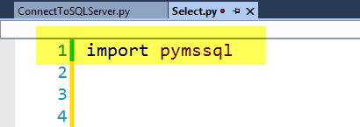
1. Install the pymssql library
If you don't already have one, create a virtual environment in your Python project
Install the python package pymssql in your virtual environment
Import the pymssql library in your code

Slide 8
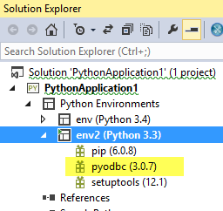
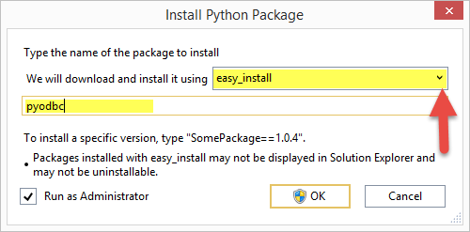
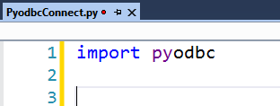
1. Install the pyodbc library
If you don't already have one, create a virtual environment for Python 3.3 in your Python project
Install the python package pyodbc in your virtual environment (use easy_install instead of pip)
Import the pyodbc library in your code

Slide 9
2. Create a connection to the database
You will need
Server name (localhost if it's the PC where code is running)
Database name
Login information (user id & password)

Slide 10
When you install SQL Server you need to ensure it will allow a user name and password for logon
SQL Server operates in two modes
Windows Authentication (uses your Windows account to log in)
Mixed/SQL Authentication (provide a username and password to log in)
For a Python website, you want to use Mixed/SQL Authentication. Find out how to ensure the correct mode and set up a system administrator login account here

Slide 11
Use the connect method to get a connection
pymssql.connect(server= 'serverName', user='userName',
password='password', database='databaseName')
Example
myConnection = pymssql.connect(server= 'localhost',
user='sa', password='P@ssw0rd',
database='QuizDB')

Slide 12
Use the connect method to get a connection
pyodbc.connect('DRIVER={DriverName};'
'SERVER=ServerName;'
'DATABASE=DatabaseName;'
'UID=userName;PWD=password')
Example
myConnection = pyodbc.connect('DRIVER={SQL Server};' 'SERVER=localhost;' 'DATABASE=QuizDb;' 'UID=sa;PWD=P@ssw0rd')

Slide 13
WARNING! Code that executes commands on a data source often raise errors

Slide 14
Add error handling to your code
print('Trying to connect')
try :
myConnection = pymssql.connect(server= 'localhost',
user='sa', password='P@ssw0rd',
database='QuizDB')
print ('Connected')
except :
print ('Could not connect')
TIP: When you are testing your code for the first time, it can be helpful to add print statements to see if your code is working

Slide 15
Add error handling to your code
print('Trying to connect')
try :
myConnection = pyodbc.connect('DRIVER={SQL Server};'
'SERVER=localhost;'
'DATABASE=QuizDb;'
'UID=sa;PWD=P@ssw0rd')
print ('Connected')
except :
print ('Could not connect')
TIP: When you are testing your code for the first time, it can be helpful to add print statements to see if your code is working

Slide 16
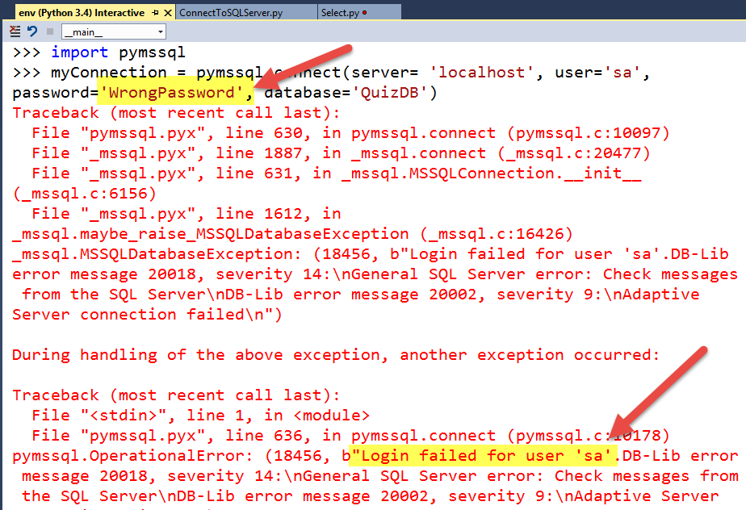
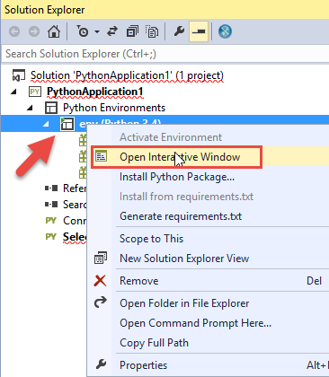
Visual Studio tip!
If you are getting errors when your database code executes use the interactive window to get detailed error messages
Right click on your environment and choose Open Interactive Window
Type your code into the interactive window and check error messages

Slide 17
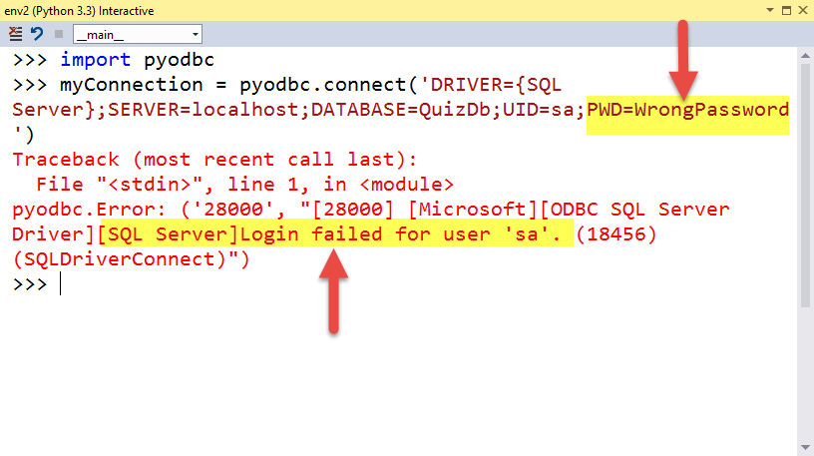
Visual Studio tip!
If you are getting errors when your database code executes use the interactive window to get detailed error messages
Right click on your environment and choose Open Interactive Window
Type your code into the interactive window and check error messages

Slide 18
Connect to SQL Server

Slide 19
How do I add a row to a table?

Slide 20

What have we done so far?
Install a library that supports connections to your database
Import library into your code
Create a connection to the database
Run the SQL Command
Save your changes (if you are modifying data)
Close the connection

Slide 21
In SQL we use the INSERT statement to add rows
Questions
QuestionName | Description | CorrectAnswer | CategoryId
HockeyFact | How long is one period of hockey? | 20 minutes | 1
FranceCapital | What is the capital of France? | Paris | 2
CanadaCapital | What is the capital of Canada? | Ottawa | 2
INSERT INTO tableName
(col1, col2,col3,…)
VALUES (val1, val2, val3, …)
INSERT INTO Questions
(QuestionName, Description, CorrectAnswer, CategoryId)
VALUES ('HockeyFact', 'How long is one period of hockey','20 minutes',1)

Slide 22
4. In Python you run a SQL command using the execute method
myCursor = myConnection.cursor()
mySQLCommand = ("INSERT INTO Questions "
"(QuestionId, Description, CorrectAnswer, CategoryId) "
"VALUES (2, 'How long is one period of hockey','20 minutes',1)")
myCursor.execute(mySQLCommand)

Slide 23
Do your cleanup
5. Save your changes (if you are modifying data) 6. Close your connection
myConnection.commit()
myConnection.close()

Slide 24
Put it all together with error handling and you have something like this
import pymssql
try :
myConnection = pymssql.connect(server= 'localhost', user='sa', password='P@ssw0rd',
database='QuizDB')
try :
myCursor = myConnection.cursor()
mySQLCommand = ("INSERT INTO Questions "
"(QuestionName, Description, CorrectAnswer, CategoryId) "
"VALUES ('HockeyFact', 'How long is one period of hockey','20 minutes',1)")
myCursor.execute(mySQLCommand)
myConnection.commit()
except:
print ('Could not insert record')
myConnection.close()
except :
print ('Could not connect')

Slide 25
Put it all together with error handling and you have something like this
import pymssql
try :
myConnection = pyodbc.connect('DRIVER={SQL Server};'
'SERVER=localhost;'
'DATABASE=QuizDb;'
'UID=sa;PWD=P@ssw0rd')
try :
myCursor = myConnection.cursor()
mySQLCommand = ("INSERT INTO Questions "
"(QuestionName, Description, CorrectAnswer, CategoryId) "
"VALUES ('HockeyFact', 'How long is one period of hockey','20 minutes',1)")
myCursor.execute(mySQLCommand)
myConnection.commit()
except:
print ('Could not insert record')
myConnection.close()
except :
print ('Could not connect')

Slide 26
Insert a row from the database

Slide 27
Retrieving a row from the database

Slide 28
In SQL we use the SELECT statement to retrieve a row from a table
QuestionName | Description | CorrectAnswer | CategoryId
HockeyFact | How long is one period of hockey? | 20 minutes | 1
FranceCapital | What is the capital of France? | Paris | 2
CanadaCapital | What is the capital of Canada? | Ottawa | 2
SELECT col1,col2, col3, …
FROM tablename
WHERE columname= searchString
SELECT Description, CorrectAnswer
FROM Questions
WHERE QuestionName = 'HockeyFact'
How long is one period of hockey?
20 minutes
description correctanswer
------------------------------------------------------------------------

Slide 29
We execute the SQL Command in Python the same way we executed the INSERT Command
myCursor = myConnection.cursor()
mySQLCommand = ("SELECT description,correctAnswer "
"FROM questions "
"WHERE QuestionName = 'HockeyFact'")
myCursor.execute(mySQLCommand)
TIP: Because we aren't changing any data, we don't need to save/commit our changes

Slide 30
But how do we access returned values in our code?
Use the fetchone() method of the cursor
fetchone returns an array that contains each column returned
Row 0 of the array contains the first column, row 1 the second column, and so on
SELECT Description, CorrectAnswer
FROM Questions
WHERE QuestionName = 'HockeyFact'
QuestionName | Description | CorrectAnswer | CategoryId
HockeyFact | How long is one period of hockey? | 20 minutes | 1
FranceCapital | What is the capital of France? | Paris | 2
CanadaCapital | What is the capital of Canada? | Ottawa | 2
How long is one period of hockey?
20 minutes
results
index | Content
0
1

Slide 31
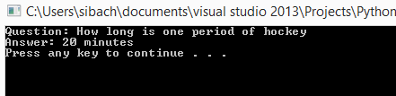
In your code that looks something like this
myCursor.execute(mySQLCommand)
results = myCursor.fetchone()
print ("Question: " + results[0])
print ("Answer: " + results[1])

Slide 32
Put it all together with error handling
import pymssql
try :
myConnection = pymssql.connect(server= 'localhost', user='sa', password='P@ssw0rd', database='QuizDB')
try :
myCursor = myConnection.cursor()
mySQLCommand = ("SELECT Description, CorrectAnswer "
"FROM Questions "
"WHERE QuestionName = 'HockeyFact'")
myCursor.execute(mySQLCommand)
results = myCursor.fetchone()
print ("Question: " + results[0])
print ("Answer: " + results[1])
except :
print ('Could not select row')
myConnection.close()
except :
print ('Could not connect')

Slide 33
Put it all together with error handling
import pyodbc
try :
myConnection = pyodbc.connect('DRIVER={SQL Server};'
'SERVER=localhost;'
'DATABASE=QuizDb;'
'UID=sa;PWD=P@ssw0rd')
try :
myCursor = myConnection.cursor()
mySQLCommand = ("SELECT Description, CorrectAnswer "
"FROM Questions "
"WHERE QuestionName = 'HockeyFact'")
myCursor.execute(mySQLCommand)
results = myCursor.fetchone()
print ("Question: " + results[0])
print ("Answer: " + results[1])
except :
print ('Could not select row')
myConnection.close()
except :
print ('Could not connect')

Slide 34
Select a row from our table

Slide 35
But what if I am using Microsoft SQL Azure?

Slide 36
All you need to change is the connection string!
myConnection = pyodbc.connect('Driver={SQL Server};'
'Server=tcp:yourservername.database.windows.net,1433;'
'Database=databasename;'
'Uid=username@servername;Pwd=password;'
'Encrypt=yes')
Example
myConnection = pyodbc.connect('Driver={SQL Server};'
'Server=tcp:123fgt7.database.windows.net,1433;'
'Database=MyAzureDatabase;'
'Uid=susanibach@123fgt7;Pwd=P@ssw0rd;'
'Encrypt=yes')

Slide 37
How does this fit into our website?

Slide 38
Update website to read from our SQL Database

Slide 39
What did we learn?
How to connect to a database using Python
How to insert a row in a table using Python
How to select data from a table using Python

